Slide 1
Smart Buy
Buy everything you need in a smart way

Slide 2
Team member
Supervisor: Mr. Kiều Trọng Khánh
Đoàn Hồ Anh Triết
Đặng Hữu Hoàng
Trần Trung Dũng
Huỳnh Thanh Việt (Dropped out)

Slide 3
Outline
Scenario problem
Our solution
Demonstration
Advantages and disadvantages of current solution
Questions and answers

Slide 4
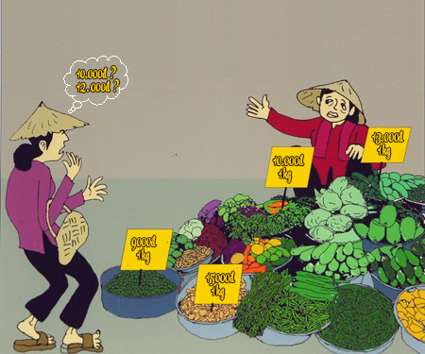
Scenario Problem

Slide 5



Our Solution
Track
Give
System
Price
Suggestion

Slide 6


Slide 7



Demo Scenario - Guest
Search Product
Add to cart.
View cart

Slide 8


Demo Scenario - Member
Define Routes
Ask for suggestion

Slide 9




Demo Scenario - Staff
Import data
Train machine
Manage parsers

Slide 10
















Smart Buy System
1.1
1.4
Guest
1.2
1.3
2.3
2.6
2.4
2.2
2.5
2.1
Member

Slide 11



Slide 12
Future Plan

Slide 13
THANK YOU FOR YOUR ATTENTION! Q & A

